Slide 1


Semester 443 - 2023, 1444
Course CS315 Algorithms Analysis and Design
Divide-and-conquer
Lecture 2
Prof. Dr Mohammed Al-Hagery
Athar alwabel
Supervisordr@yahoo.com
aa.alwabel@qu.edu.sa

Slide 2

What is Divide and Conquer?
An effective approach to designing fast algorithms in sequential computation is the method known as divide and conquer.
Strategy :-
Divide:
A problem to be solved is broken into a number of sub problems of the same form as the original problems;
Conquer:
The sub problems are then solved independently, usually recursively;
Combine:
Finally, the solutions to the sub problems are combined to provide the answer to the original problem.
Classic example
Sorting algorithms
1- merge sort
2- quicksort

Slide 3
Sorting
Sorting with insertion sort and Merge sort
Study divide-and-conquer with Merge Sort
Skills:
  Analyzing correctness of iterative and recursive algorithms.
  Analyzing running time of recursive algorithms.
How do we measure the runtime of an algorithm?
  Worst-case analysis
  Asymptotic Analysis

Slide 4
Sorting
- Important primitive
- For today, we’ll pretend all elements are distinct.
6
4
3
8
1
5
2
7
1
2
3
4
5
6
7
8

Slide 5
Benchmark: insertion sort
Say we want to sort:
Insert items one at a time.
How would we actually implement this?
6
4
3
8
5

Slide 6
Insertion sort example…
6
4
3
8
5
Start with the second element (the first element is sorted within itself…)
4
6
3
8
5
Pull “4” back until it’s in the right place.
4
6
3
8
5
Now look at “3”
3
4
6
8
5
Pull “3” back until it’s in the right place.
3
4
6
8
5
“8” is good…look at 5
3
4
6
5
8
(then fix 5 and we’re done)

Slide 7
Insertion sort pseudocode
Go one-at-a-time until things are in the right place.
6
4
3
8
5
4
6
3
8
5
1- Apply the steps of the algorithim on the example on the right
2- Also, practice with this algorithm to calculate the prime Ops.

Slide 8
Insertion sort: running time
n-1 iterations of the outer loop
In the worst case, about n iterations of this inner loop
Running time is about n²

Slide 9
Insertion sort: correctness
loop invariant: is something that should be true at every iteration.
الحلقة الثابتة
Initialization: the loop invariant holds before the first iteration.
Maintenance: If it is true before the t’th iteration, it will be true before the (t+1)’st iteration
Termination: It is useful to know that the loop invariant is true at the end of the last iteration.
Note: the cost of comparison is higher than the cost of a swap.

Slide 10
To summarize
InsertionSort is an algorithm that correctly sorts an arbitrary n-element of an array in time about n².

Slide 11
Can we do better?
MergeSort: a divide-and-conquer approach Recall from last time:
Divide and Conquer:
Big problem
Smaller problem
Smaller problem
Recurse!
Recurse!
Yet smaller problem
Yet smaller problem
Yet smaller problem
Yet smaller problem

Slide 12
Merge Sort
6
4
3
8
1
5
2
7
6
4
3
8
1
5
2
7
Recursive magic!
Recursive magic!
3
4
6
8
1
2
5
7
MERGE!
1
2
3
4
5
6
7
8
(MERGE pseudocode + analysis )
(A good exercise: how would I do this in place?)

Slide 13
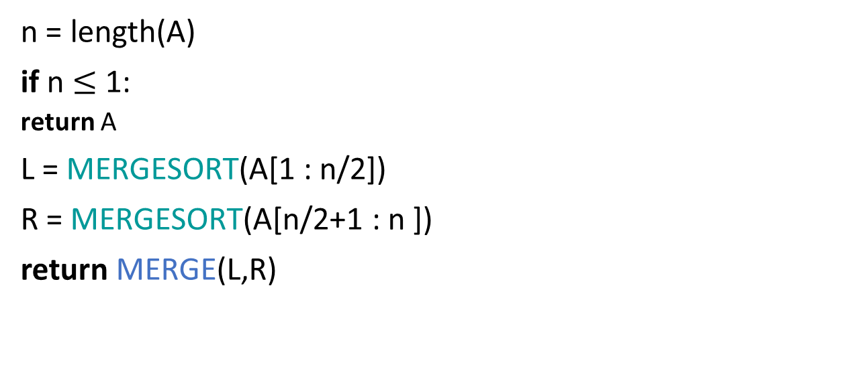
Merge Sort Pseudocode
MERGESORT(A):
n = length(A)
if n $≤$ 1:
  return A
L = MERGESORT(A[1 : n/2])
R = MERGESORT(A[n/2+1 : n ])
return MERGE(L,R)
If A has length 1,
It is already sorted!
Sort the left half
Sort the right half
Merge the two halves
Two questions
Does this work?
Is it fast?

Slide 14
Schematic of recursive calls
Sorted sequence!
1
2
3
4
5
6
7
8
Merge!
3
4
6
8
1
2
5
7
Merge!
Merge!
4
6
3
8
1
5
2
7
Merge!
Merge!
Merge!
Merge!
6
4
3
8
1
5
2
7
Original sequence

Slide 15
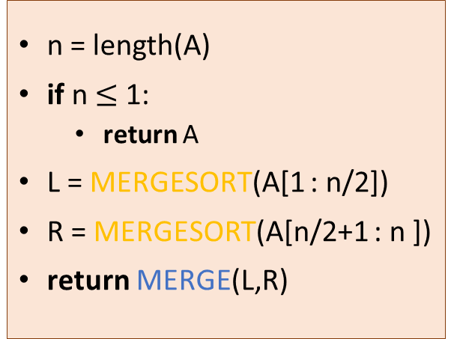
It works
Not technically a “loop invariant,” but a ”recursion invariant,” that should hold at the beginning of every recursive call.
Invariant:
“In every recursive call,
MERGESORT returns a sorted array.”
n = length(A)
if n $≤$ 1:
  return A
L = MERGESORT(A[1 : n/2])
R = MERGESORT(A[n/2+1 : n ])
return MERGE(L,R)
  Base case (n=1): a 1-element array is always sorted.
  Maintenance: Suppose that L and R are sorted. Then MERGE(L,R) is sorted.
  Termination: “In the top recursive call, MERGESORT returns a sorted array.”
Merge sort , on the other hand, runs in O(n*log n) time in all the cases

Slide 16
n log(n) vs n²
All logarithms in this course are base 2
log(n) : how many times do you need to divide n by 2 in order to get down to 1?
32
16
8
4
2
1
64
32
16
8
4
2
1
log(128) = 7
log(256) = 8
log(512) = 9
.
.
.
Note:log(n) grows very slowly with n.
log(32) = 5
log(64) = 6

Slide 17
nlog(n) vs n²
continued
n | n log(n) | n²
8 | 24 | 64
16 | 64 | 256
32 | 160 | 1024
64 | 384 | 4096
128 | 896 | 16384
256 | 2048 | 65536
512 | 4608 | 262144
1024 | 10240 | 1048576

Slide 18
Merge Sort Analysis
T(n) = time to run MERGESORT on a list of size n
T(n) = T(n/2) + T(n/2) + T(MERGE)
We will see later how to analyze recurrence relations like these automagically…but today we’ll do it from first principles.

Slide 19
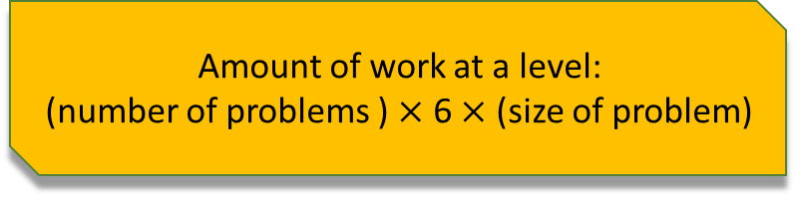
Analysis of Recursion tree of merge sort
Size of each
problem
Amount of work at this level
(just MERGEing)
#
problems
Level
Size n
0
1
2
4
2^{t}
n
n
n/2
n/4
n/2^{t}
1
6n
6n
6n
6n
6n
n/2
n/2
1
n/4
n/4
n/4
n/4
2
…
…
Amount of work at a level:
(number of problems ) $×$ 6 $×$ (size of problem)
n/2^{t}
n/2^{t}
n/2^{t}
n/2^{t}
n/2^{t}
n/2^{t}
t
…
…
log(n)
(Size 1)

Slide 20
Quick Sort
- What is the main Idea in quick sort algorithm ?
- What is the difference between quicksort and merge sort.

Slide 21
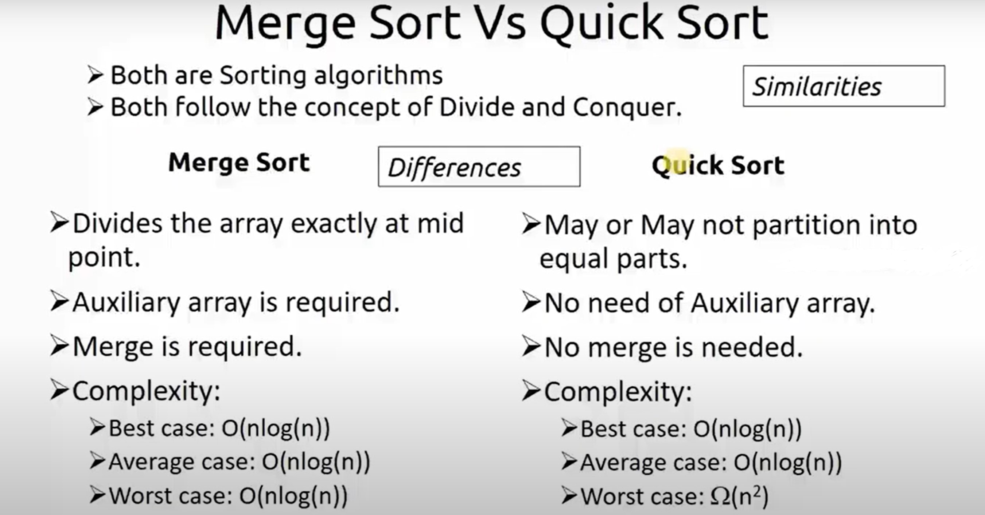

Slide 22
The End ..
This lecture was from
Algorithm Design: Foundations, Analysis, and Internet Examples
By Michael T. Goodrich, Roberto Tamassia
chapter 5.2
Introduction to Algorithms, fourth edition Hardcover – 5 April 2022
by Thomas H. Cormen
chapter 4
https://www.youtube.com/watch?v=Kg4bqzAqRBM
https://www.interviewkickstart.com/learn/quicksort-vs-merge-sort#:~:text=Merge%20sort%20generally%20performs%20fewer,in%20common%20real%2Dlife%20settings.

